Slide 1







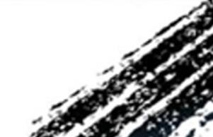

ATAI
Advanced Technique of Artificial Intelligence
ATAI
ChongqingUniversity _{AdvancedTechniqueof}
of Technology Artificial Intelligence
Chongqing University of Technology
Chongqing University ^{ATAI}
_{of Technology} Advanced Techniqueof
Artificial Intelligence
Chongqing University of Technology
Chongqing University of Technology
GRAMIAN MULTIMODAL REPRESENTATION
LEARNING AND ALIGNMENT
code:https://ispamm.github.io/GRAM/.
—— ICLR ’25
Reported by Shu Ming Jiang
1

Slide 2
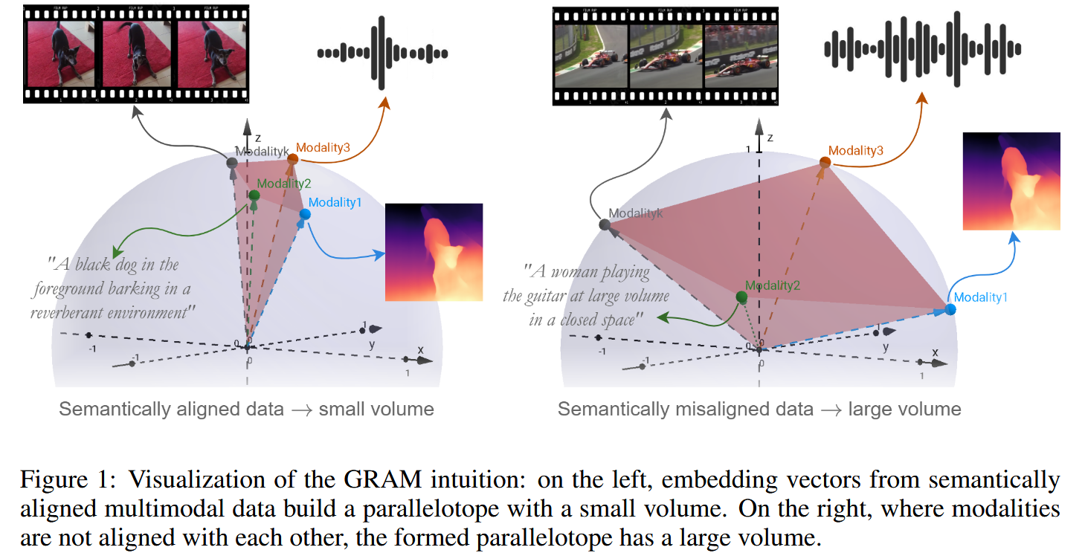
ATAI
Advanced Technique of
Artificial Intelligence
ATAI
ChongqingUniversity _{AdvancedTechniqueof}
of Technology Artificial Intelligence
Chongqing University of Technology
Motivation
1)Previous models have serious limitations because they typically use cosine similarity to align each modality to a selected anchor modality (e.g., image, text, or audio) without ensuring consistent alignment between non-anchor modalities. For example, aligning video and audio separately to a common text anchor does not ensure that the video and audio themselves are perfectly aligned.

Slide 3
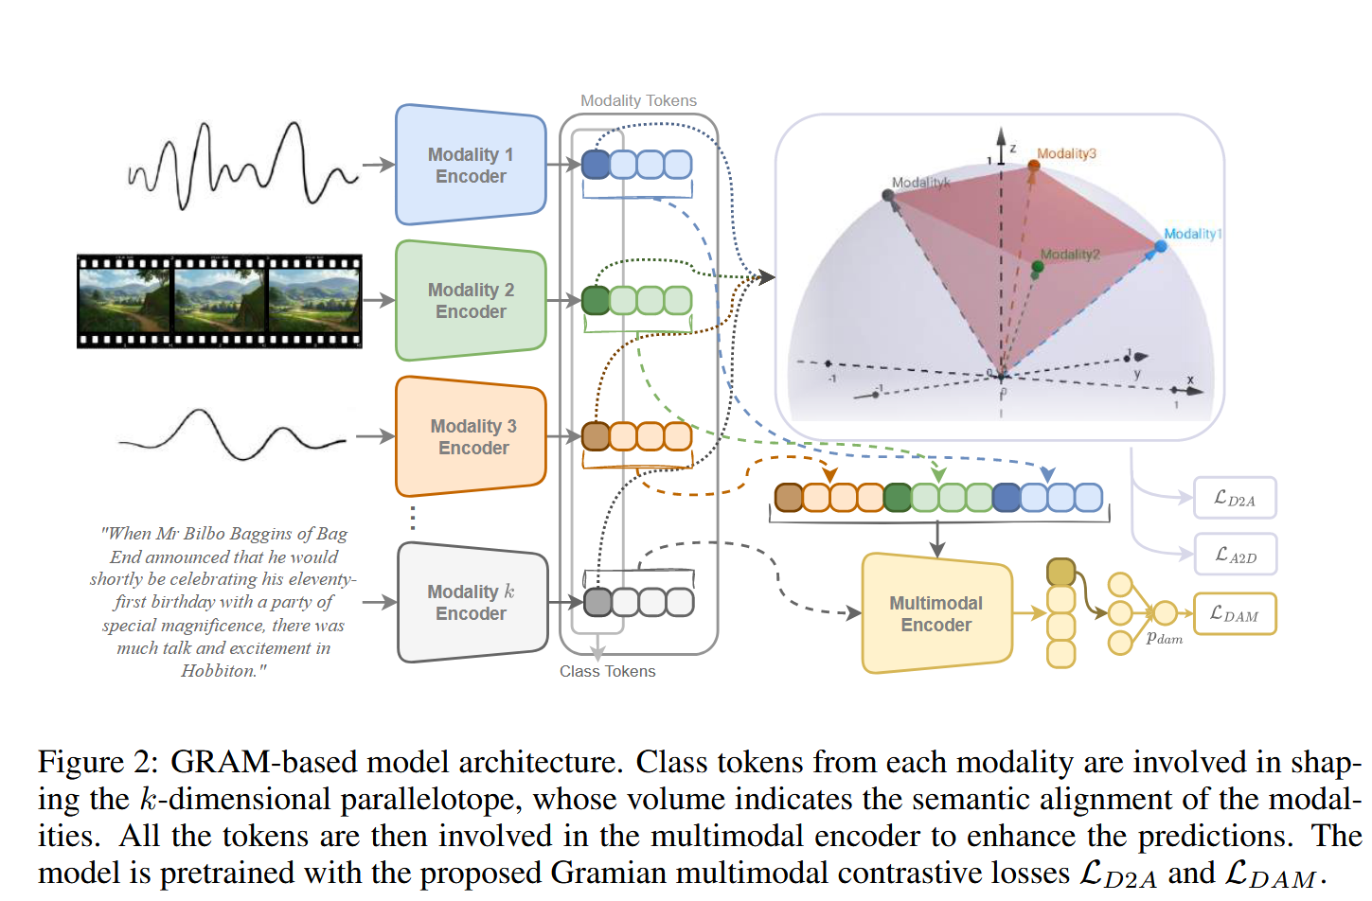
ATAI
Advanced Technique of
Artificial Intelligence
ATAI
ChongqingUniversity _{AdvancedTechniqueof}
of Technology Artificial Intelligence
Chongqing University of Technology
Overview

Slide 4
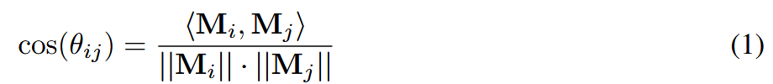
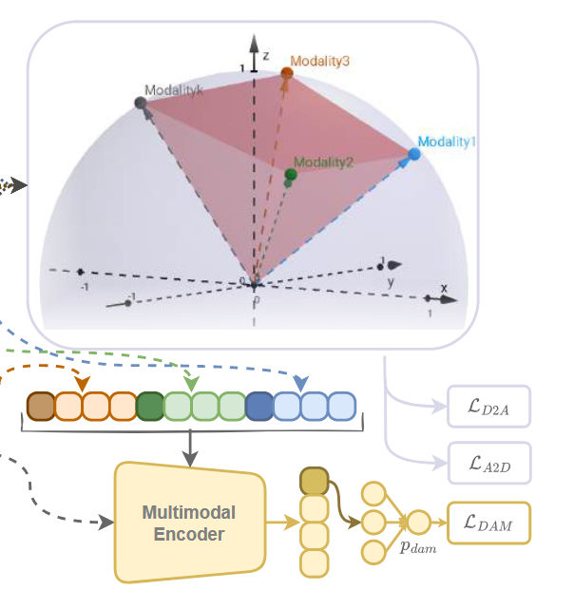
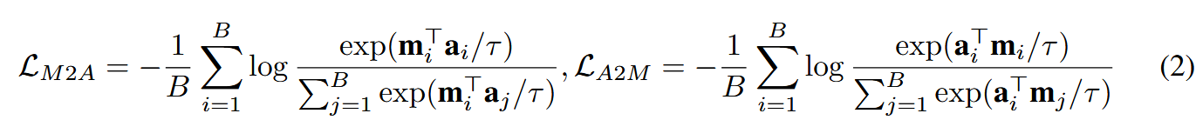
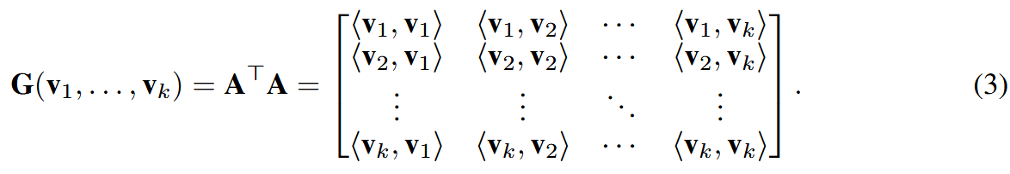
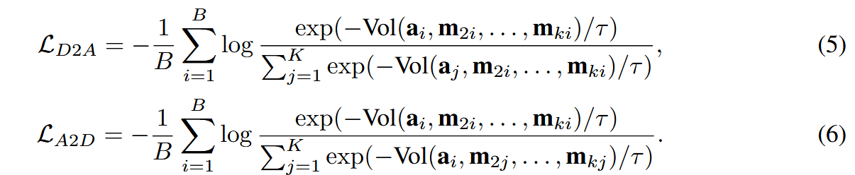
ATAI
Advanced Technique of
Artificial Intelligence
ATAI
ChongqingUniversity _{AdvancedTechniqueof}
of Technology Artificial Intelligence
Chongqing University of Technology
Method

Slide 5
ATAI
Advanced Technique of
Artificial Intelligence
ATAI
ChongqingUniversity _{AdvancedTechniqueof}
of Technology Artificial Intelligence
Chongqing University of Technology
Method

Slide 6
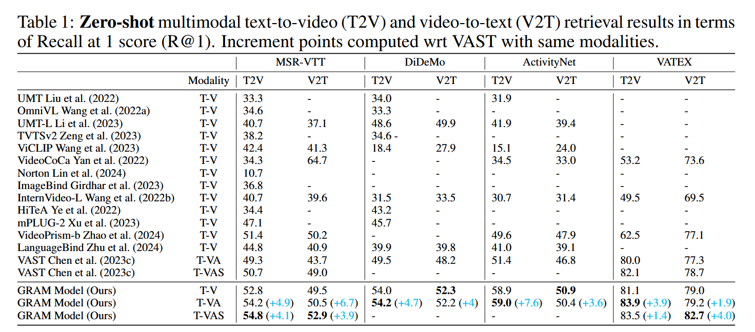
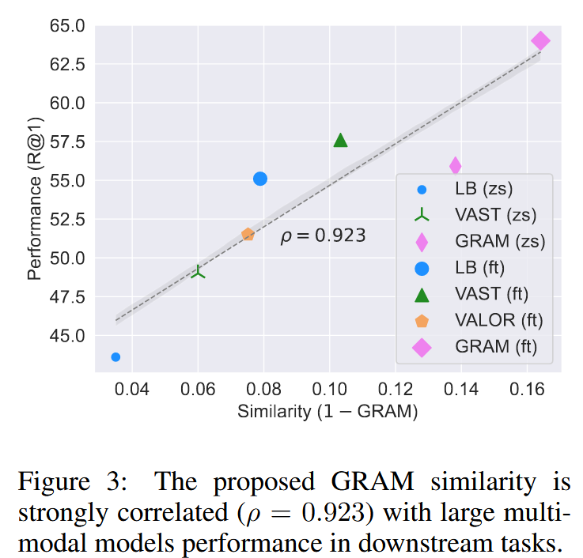
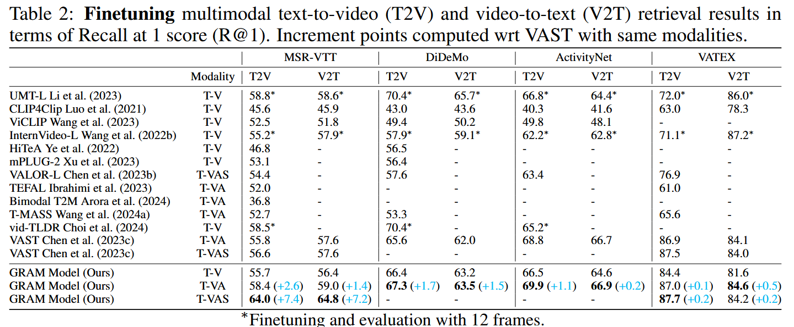
ATAI
Advanced Technique of
Artificial Intelligence
ATAI
ChongqingUniversity _{AdvancedTechniqueof}
of Technology Artificial Intelligence
Chongqing University of Technology
Experiments

Slide 7
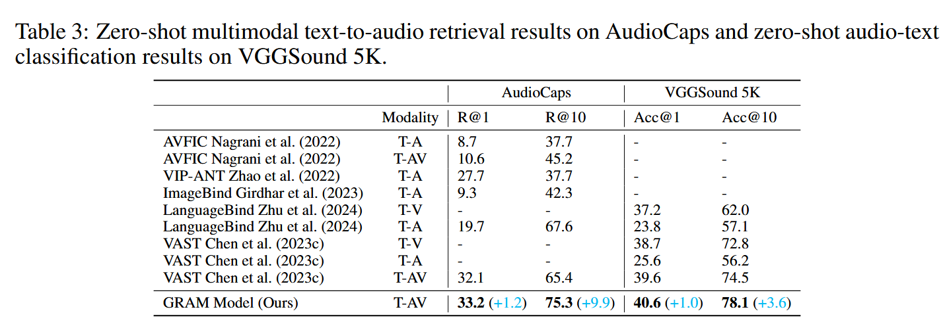
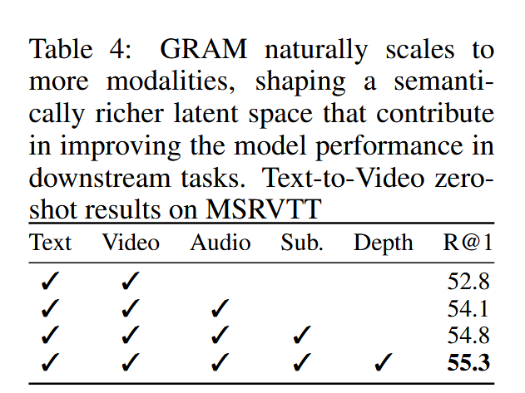
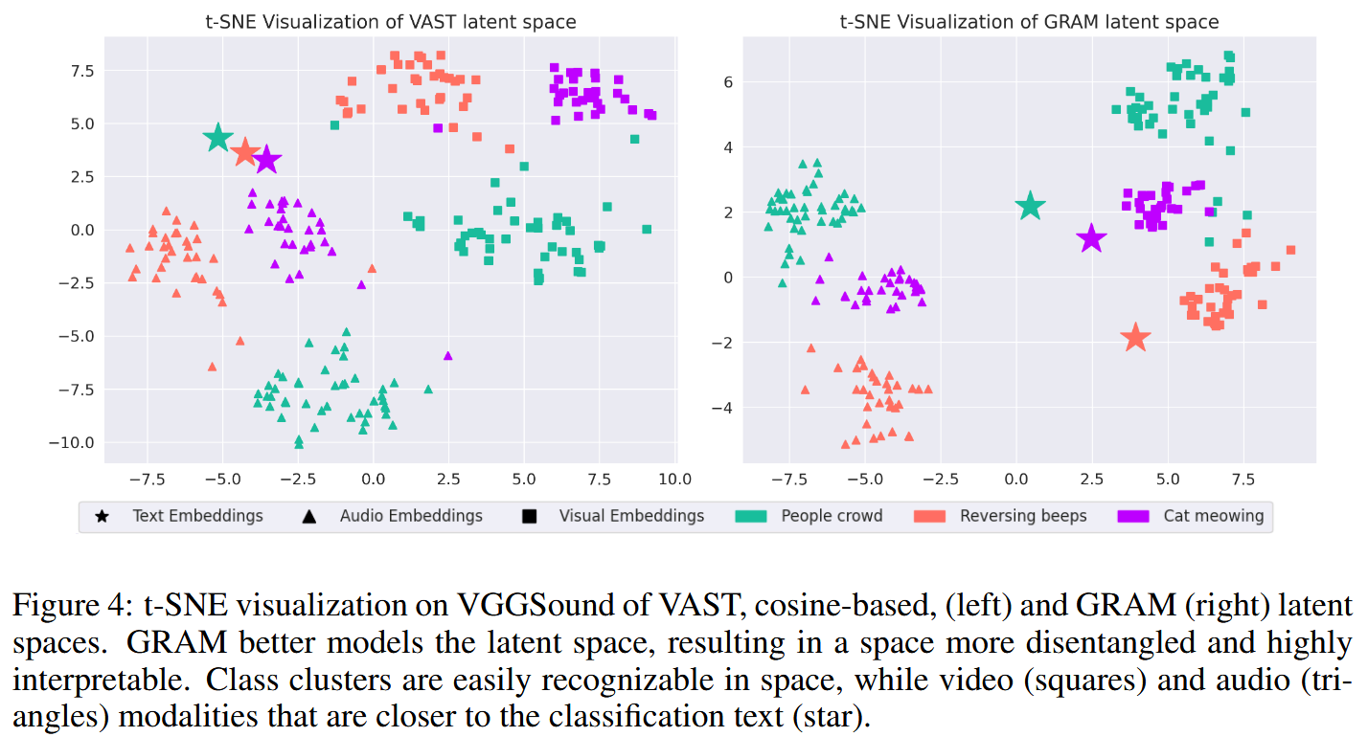
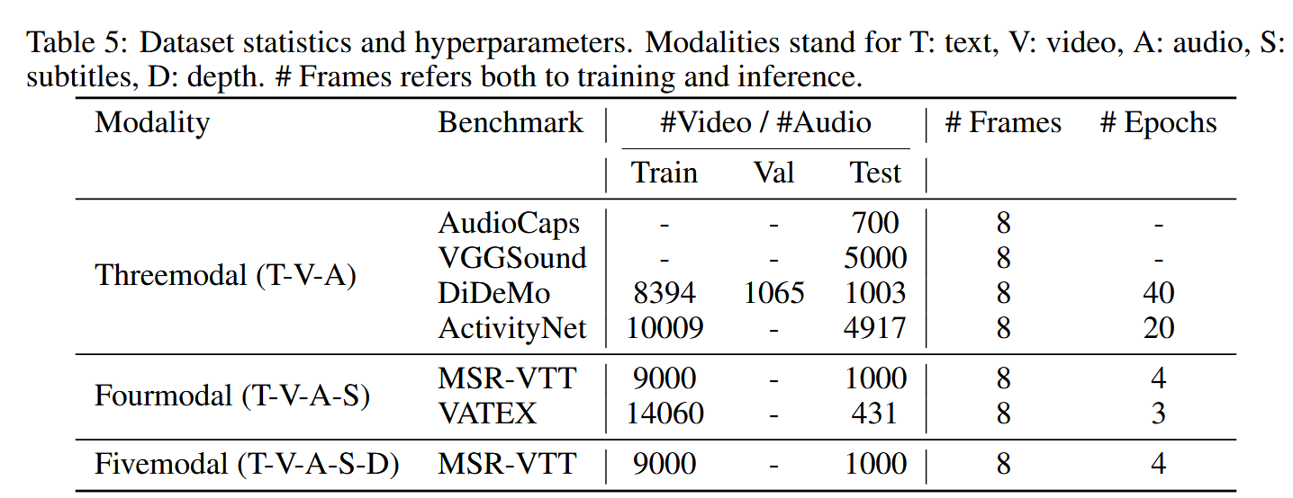
ATAI
Advanced Technique of
Artificial Intelligence
ATAI
ChongqingUniversity _{AdvancedTechniqueof}
of Technology Artificial Intelligence
Chongqing University of Technology
Experiments

Slide 8
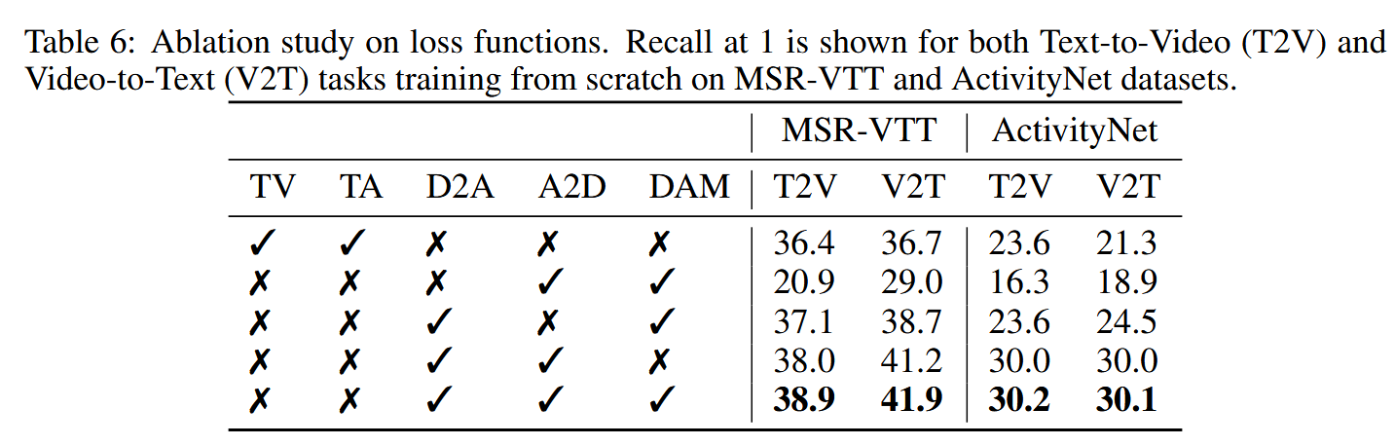
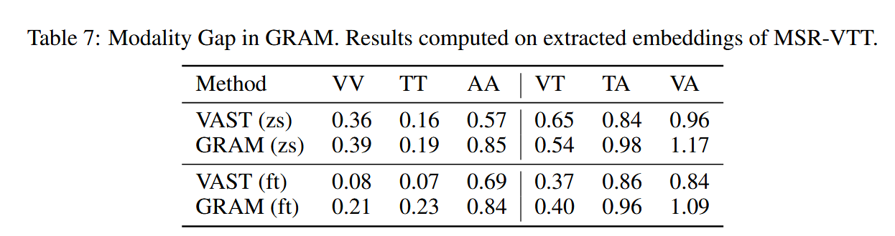
ATAI
Advanced Technique of
Artificial Intelligence
ATAI
ChongqingUniversity _{AdvancedTechniqueof}
of Technology Artificial Intelligence
Chongqing University of Technology
Experiments

Slide 9
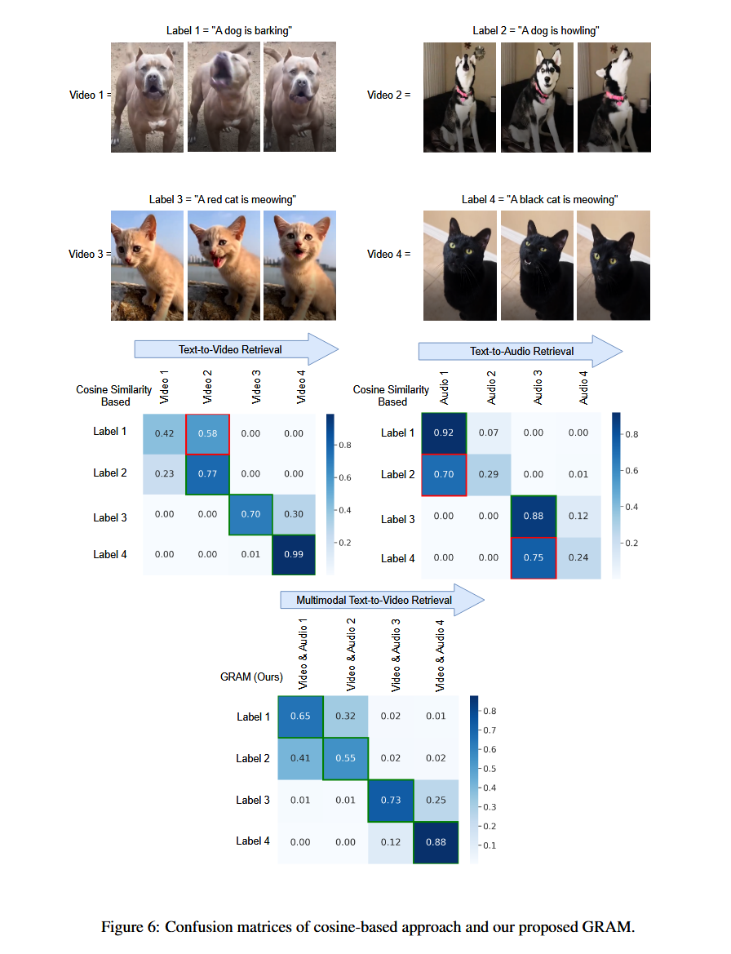
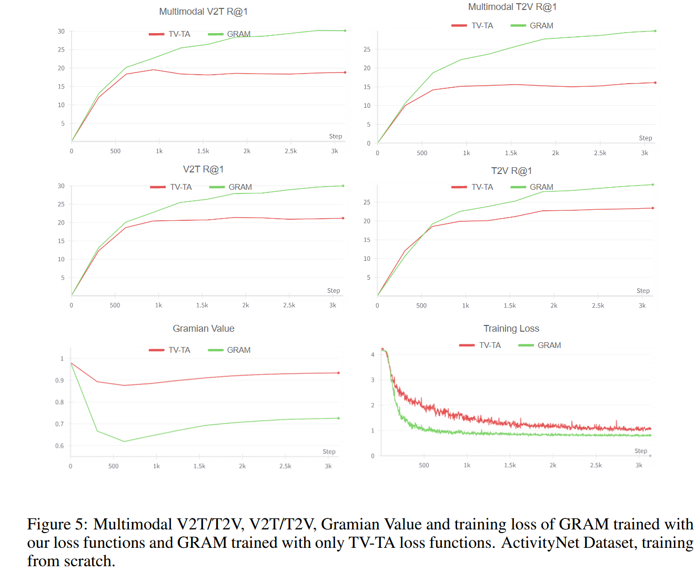
ATAI
Advanced Technique of
Artificial Intelligence
ATAI
ChongqingUniversity _{AdvancedTechniqueof}
of Technology Artificial Intelligence
Chongqing University of Technology
Experiments

Slide 10
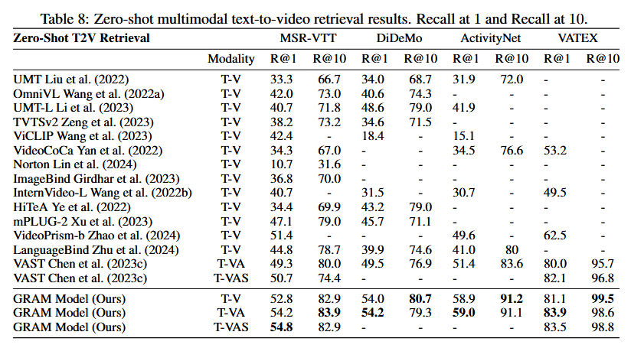
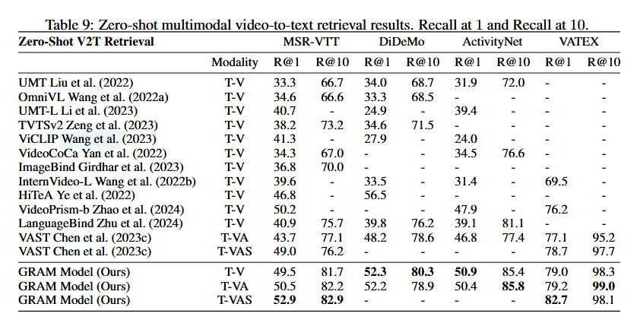
ATAI
Advanced Technique of
Artificial Intelligence
ATAI
ChongqingUniversity _{AdvancedTechniqueof}
of Technology Artificial Intelligence
Chongqing University of Technology
Experiments

Slide 11
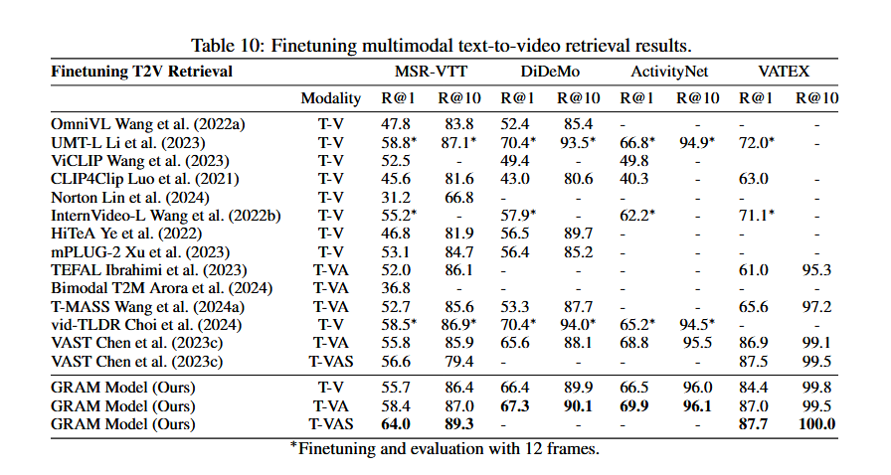
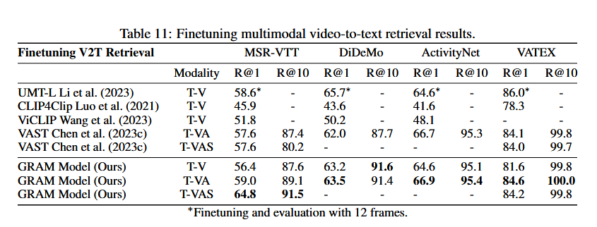
ATAI
Advanced Technique of
Artificial Intelligence
ATAI
ChongqingUniversity _{AdvancedTechniqueof}
of Technology Artificial Intelligence
Chongqing University of Technology
Experiments

Slide 12


ChongqingUniversity of Technology
ATAI
Advanced Technique of
Artificial Intelligence
ATAI
ChongqingUniversity _{AdvancedTechniqueof}
of Technology Artificial Intelligence
Chongqing University of Technology
Thanks!

